Slide 1
SPREP EMG Cook Islands Mission 25th – 29th July 2022

Slide 2
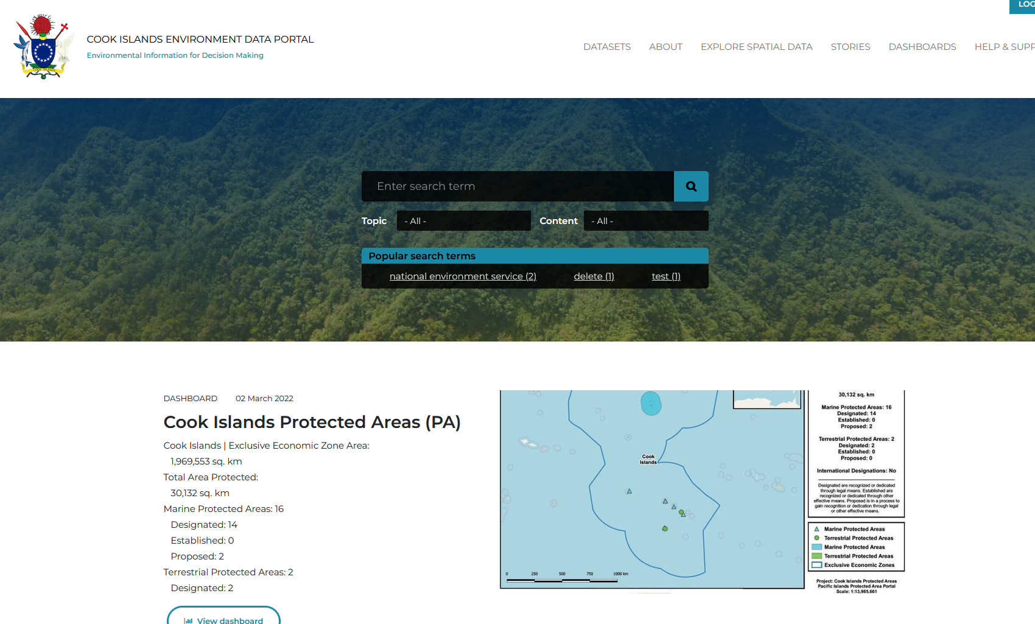
What is the Cook Islands Environment Data Portal?
Online repository to store and share environmental data useful to monitor Cook Islands state of environment.
Open Source tool : DKAN Open Data Platform
Cloud or in-country hosting
Publishing platform

Slide 3
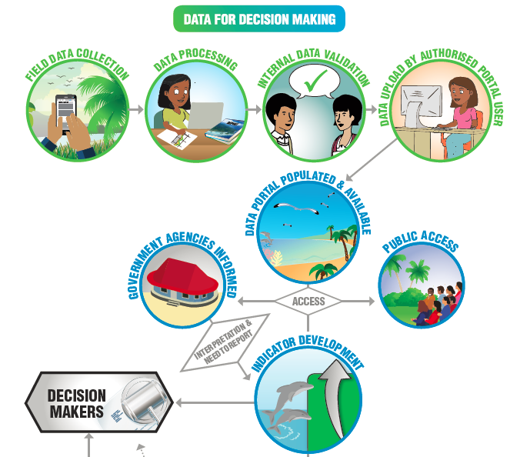

Slide 4
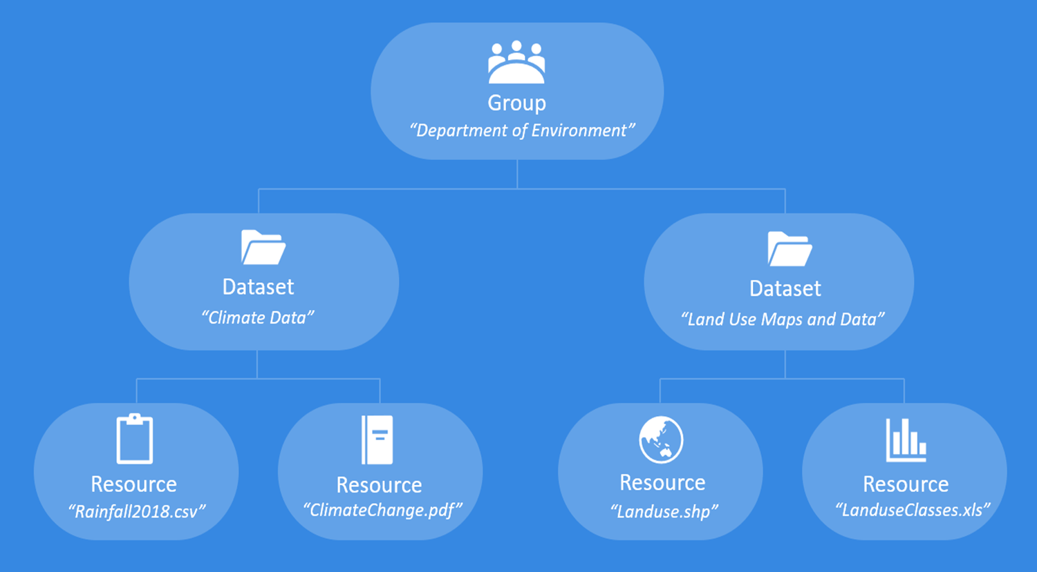
Portal Building Block

Slide 5
Dataset vs Resource
DATASET
RESOURCE

Slide 6
Think of some potential datasets that could assist the NES team, shareholders or the public.
Location of areas affected by king tides
Area of shorelines lost to rising sea levels
Number of permits granted for new developments
Number of applications received for EIA consideration
Number of offences relating to litter
Status of protected areas
Pre and Post COVID levels of litter in public spaces
NES yearly allocated budget

Slide 7
3 easy steps to upload data
STEP 1
STEP 2
STEP 3

Slide 8
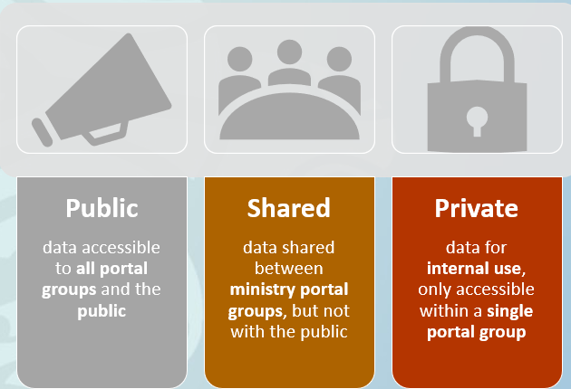
Data Sharing License Levels

Slide 9
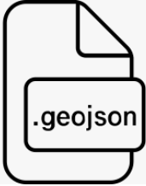
What type of data can you upload?
The data portal supports many file types, including:
csv, html, xls, json, xlsx, doc, docx, rdf, txt, jpg, png, gif, tiff, pdf, odf, ods, odt, tsv, geojson and xml.

Slide 10
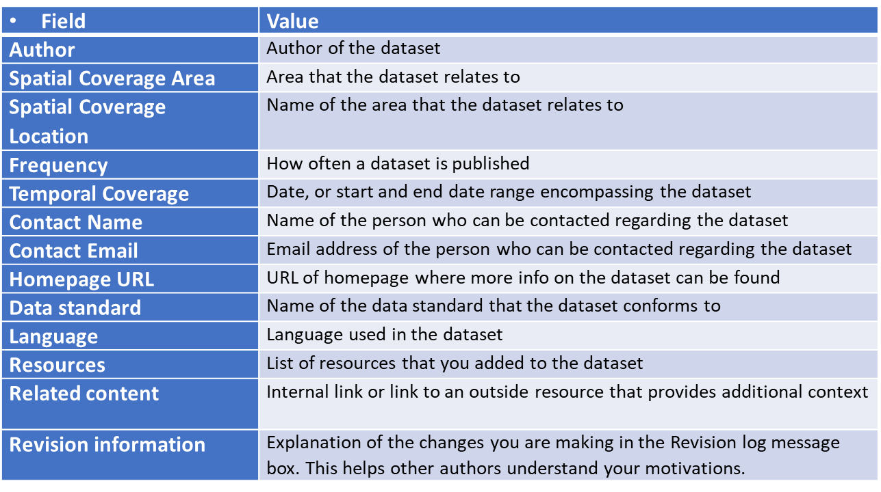
Metadata
Data about the data

Slide 11
Social Media
Public sharing options – dataset level

Slide 12
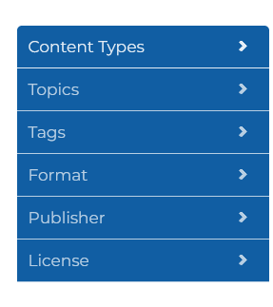
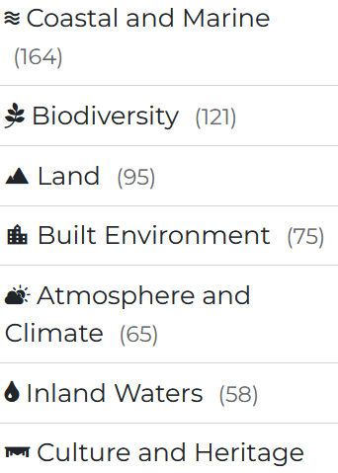
Finding Data on the Portal
You can search for data or information by content types
shows list of all uploaded formats
allows you to search for images, gis files
shows all Groups that have published data
number of available datasets per group
allows you to see all datasets per group
shows the 3 license levels
number of available datasets per level
allows you to search for public data

Slide 13
Data Exercise Session

