Slide 1




Consultation & planning workshop
Rarotongan Beach Resort
06.03.2024

Slide 2
Workshop Objectives
To familiarise participants with the RESPONSE project
To gain insight, input and ideas for project planning
To identify potential barriers & challenges

Slide 3
Housekeeping
Please ensure you sign the registration sheet
Bathrooms opposite the meeting room
Group photo at morning tea
Informal workshop – please ask questions & share your thoughts!

Slide 4
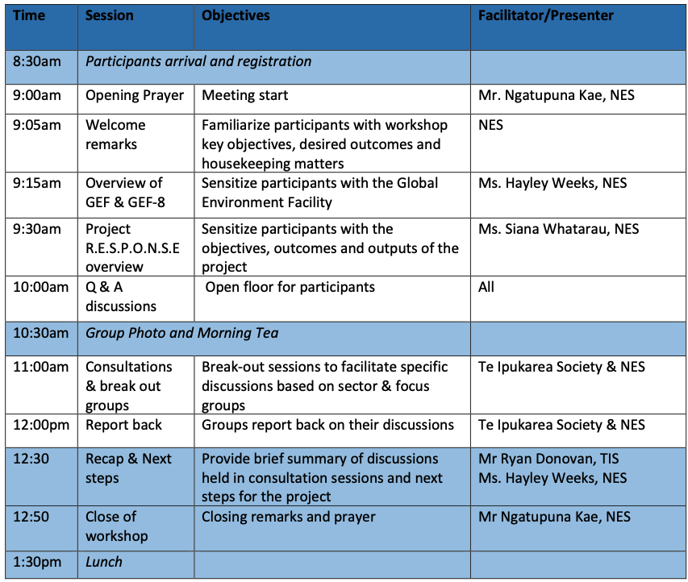
Agenda

Slide 5
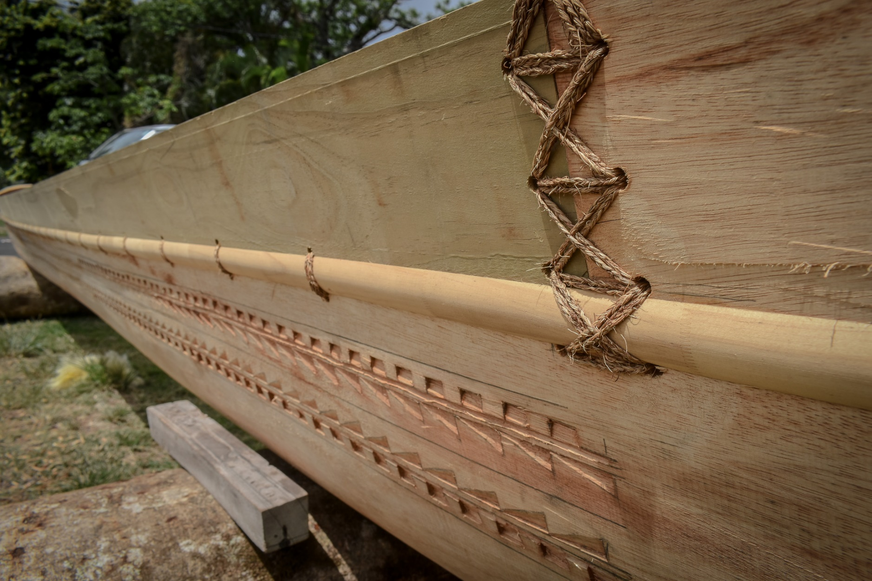
1. Overview of the GEF & GEF-8

Slide 6
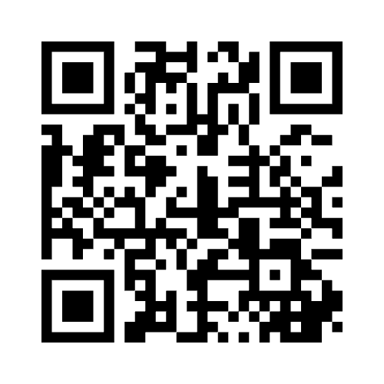
Wake up activity!
Join the quiz at:
Menti.com |Code: 6208 2175

Slide 7



What is the GEF?
Global Environment Facility
International environment fund, est 1991
Purpose is to support countries achieve their commitments to mulitlateral environment agreements

Slide 8
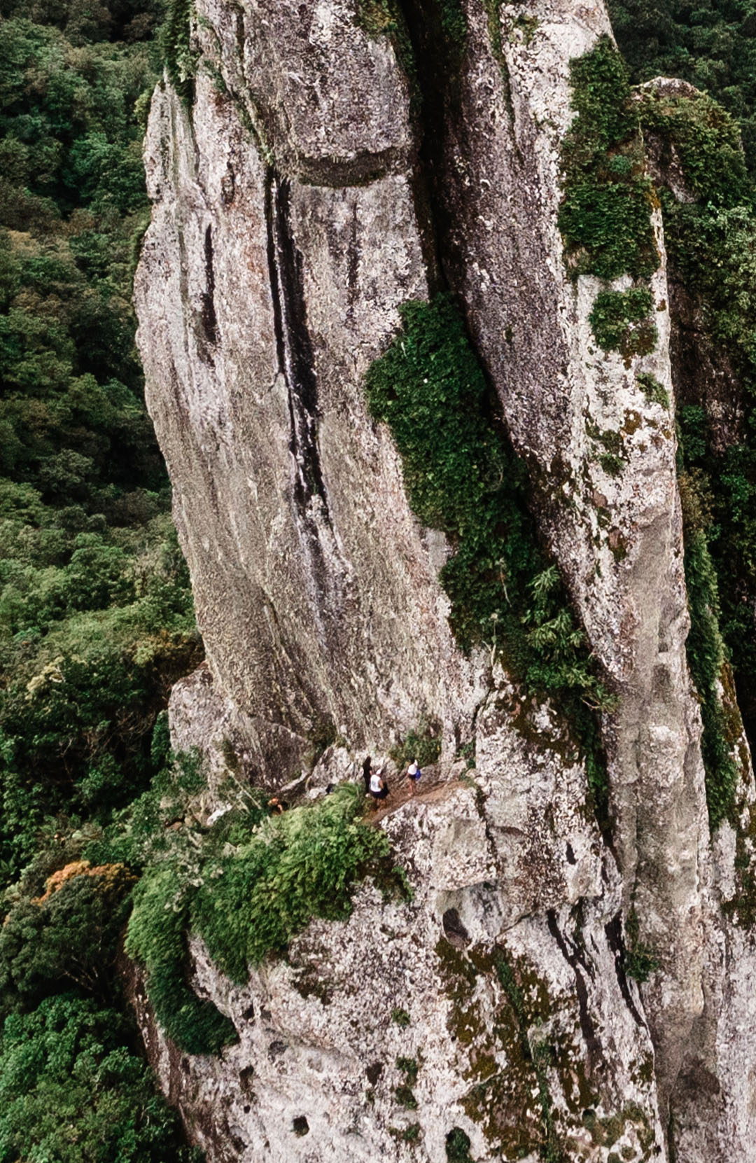
GEF Funding
GEF Trust Fund
Funds are replenished every 4 years = new GEF cycle
185 member countries, 164 eligible countries
40 donor countries (Germany, Japan, USA, Sweden = top donors) in GEF 8
GEF Trustee = World Bank

Slide 9
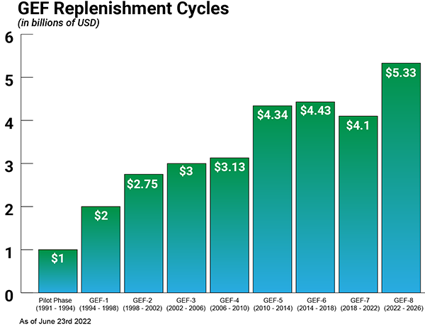

Slide 10
What does GEF support?
Biodiversity
Land degradation
Climate Change
Chemicals & waste
International waters

Slide 11



Cook Islands GEF projects

Slide 12
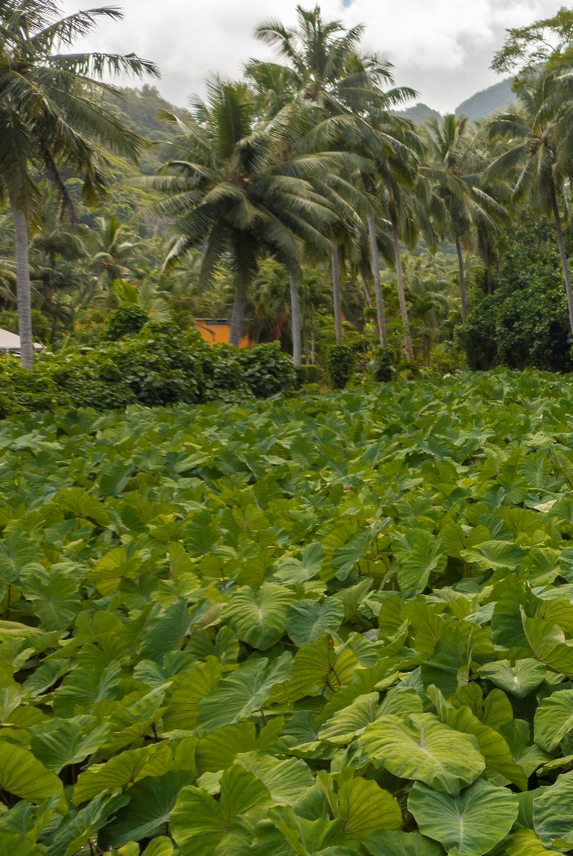
NES’ ROLE
GEF Operational Focal Point
Responsible for operations of GEF activities
Ensuring projects are in line with national priorities
Main point of contact for GEF, agencies & key stakeholders

Slide 13

GEF 8
8th GEF funding cycle
2022 – 2026
National Dialogue, Apr 2023:
  Water security
  Waste management
  Biodiversity

Slide 14
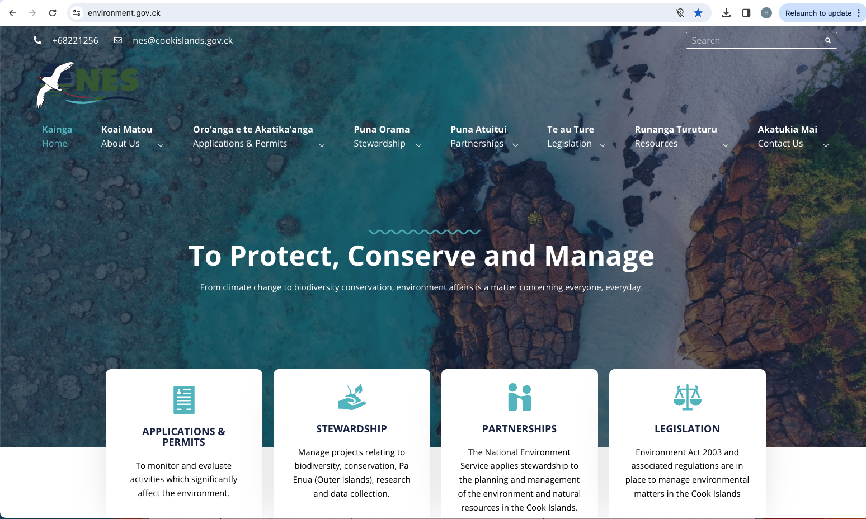

Slide 15

meitaki

